Slide 1
OPERATING SYSTEM ARCHITECTURE
PREPARED BY:
Sameep Dhakal
Surendra Raj Pandey

Slide 2
Software Concepts:
Network Operating System
Distributed Operating System
Middleware Operating System

Slide 3
Network Operating System
Build using distributed system from a network of workstations connected by high speed network
Loosely coupled architecture pattern
Advantages:
Scalability- many computers supported
Disadvantage:
Fail to provide single coherent view.

Slide 4
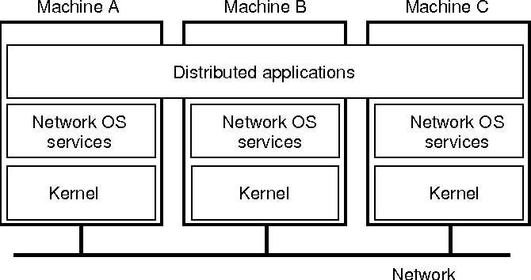
Network operating system

Slide 5
Distributed Operating System
Consist of separate uniprocessors uses a separate uniprocessor OS on each computer for communicating between different computers.
Tightly coupled architecture pattern.
Disadvantage:
Scalability-support limited number of independent computers

Slide 6
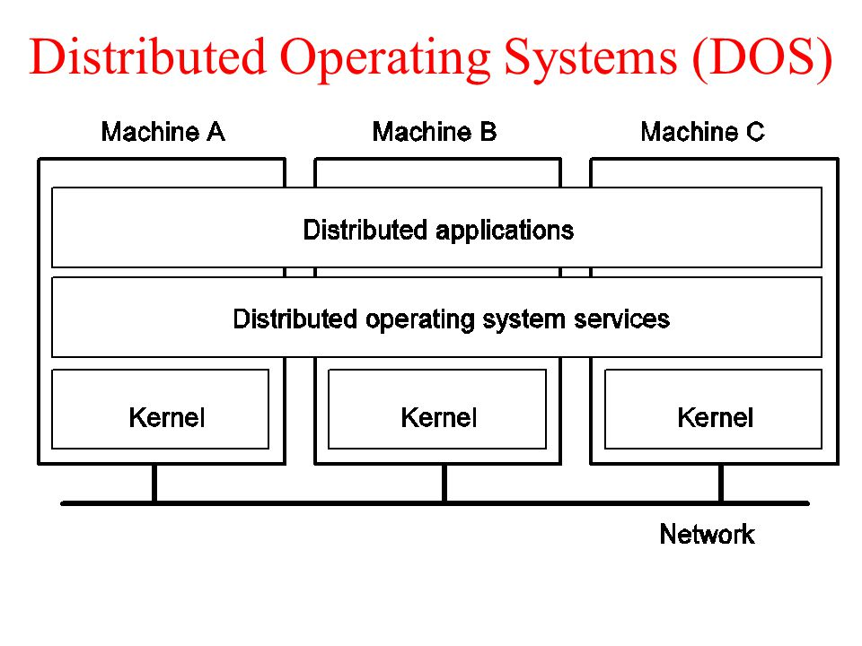
Distributed Operating System

Slide 7
Middleware OPERATING SYSTEM
It is used to overcome disadvantages of DOS and NOS.
It is used as new layer formed between DOS and NOS
It provides:
Common set of services – for local applications
Independent set of services-for distributed application
It also provide Heterogenity.

Slide 8
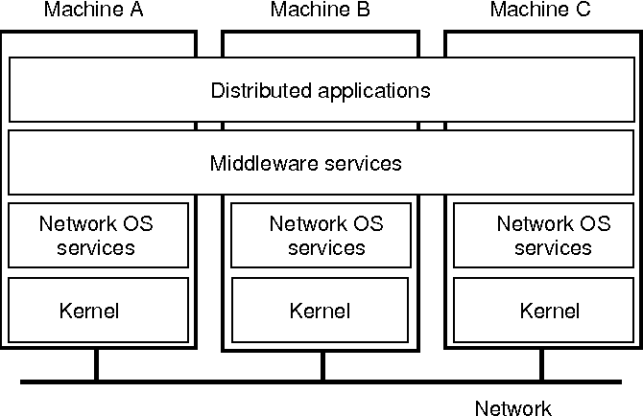
Middleware OPERATING SYSTEM

Slide 9
System Architecture
The kernel is a computer program at the core of a computer's operating system and has complete control over everything in the system.
Major kernel architectures:
Monolithic Kernels
Micro-Kernels

Slide 10
Monolithic Kernel
Entire OS is present on kernel Space.
user services and kernel services are implemented under same address space.
Increased size of kernel increases size of operating system
All the basic services of OS like process management, file management, memory management, exception handling, process communication etc. are all present inside the kernel only.

Slide 11
Monolithic kernel
Advantages
it provides CPU scheduling, memory management, file management and other operating system functions through system calls.
The other one is that it is a single large process running entirely in a single address space
Disagvantages:
if any service fails it leads to entire system failure.
If user has to add any new service. User needs to modify entire operating system.

Slide 12
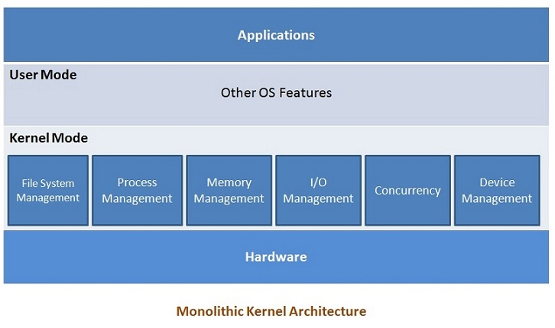

Slide 13
MICROKERNEL
The basic ideology in this architecture is to keep the kernel as small as possible and hence it should be meant for handling the most important services only.
only the most important services are put inside the kernel and rest of the OS service are present in the system application program.
Microkernel and system applications can interact with each other by message passing as and when required

Slide 14
Microkernel
Advantages:
The architecture of this kernel is small and isolated hence it can function better.
Expansion of the system is easier, it is simply added in the system application without disturbing the kernel.
Fewer system crashes when compared with monolithic systems.
Disadvantages:
Providing services in a microkernel system are expensive compared to the normal monolithic system

Slide 15
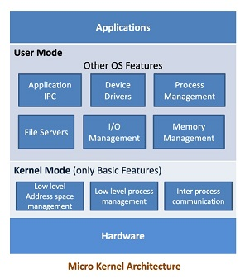

Slide 16
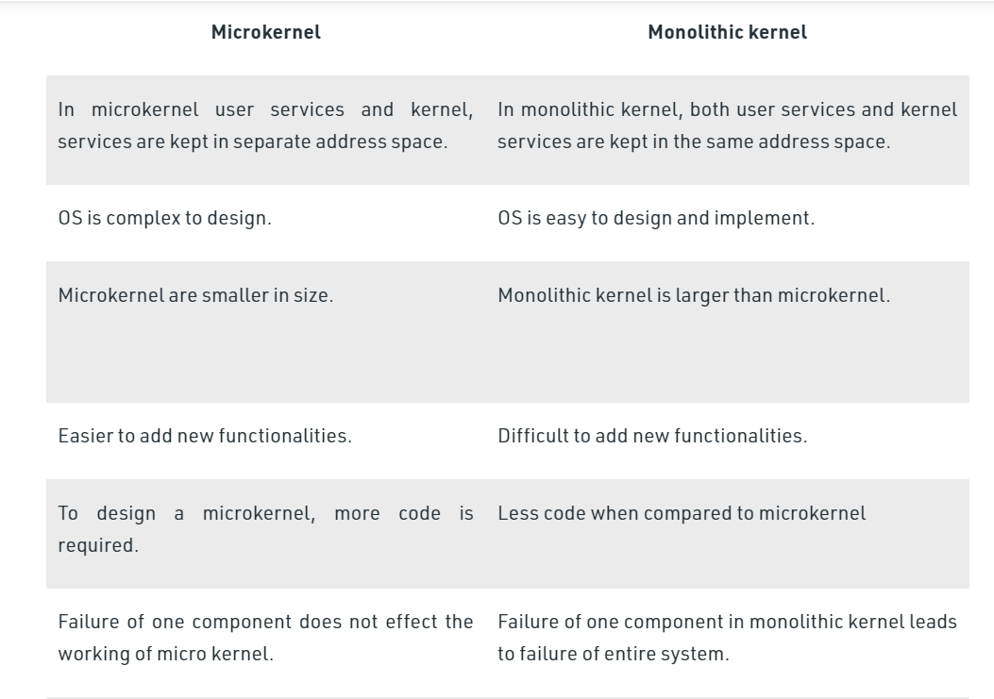
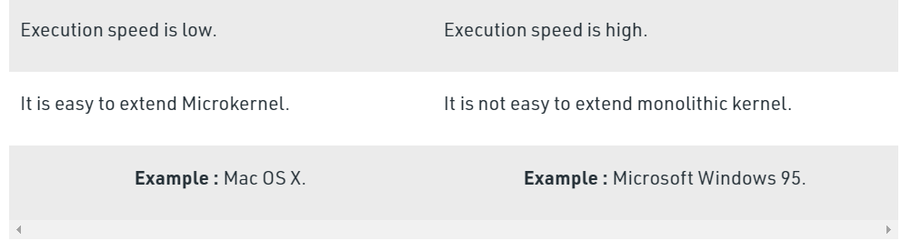
MOnOLITHIC VS MICROKERNEL

Slide 17
Hybrid Approaches
This kernel approach combines the speed and simpler design of monolithic kernel with the modularity and execution safety of microkernel.
Pure microkernel operating system such as Chorus & Mach have changed over a time to allow servers to be loaded dynamically into the kernel address space or into a user-level address space.
In some operating system such as SPIN, the kernel and all dynamically loaded modules grafted onto the kernel execute within a single address space.

Slide 18
THANK YOU

